Slide 1



Let’s play ‘Dart’ game
Jaldeep Asodariya
Sr. Mobile App Developer, GoHighLevel
@jaldeepasodariy
India

Slide 2
Hands-on
Overview

Slide 3
Basic of Dart
Class

Slide 4
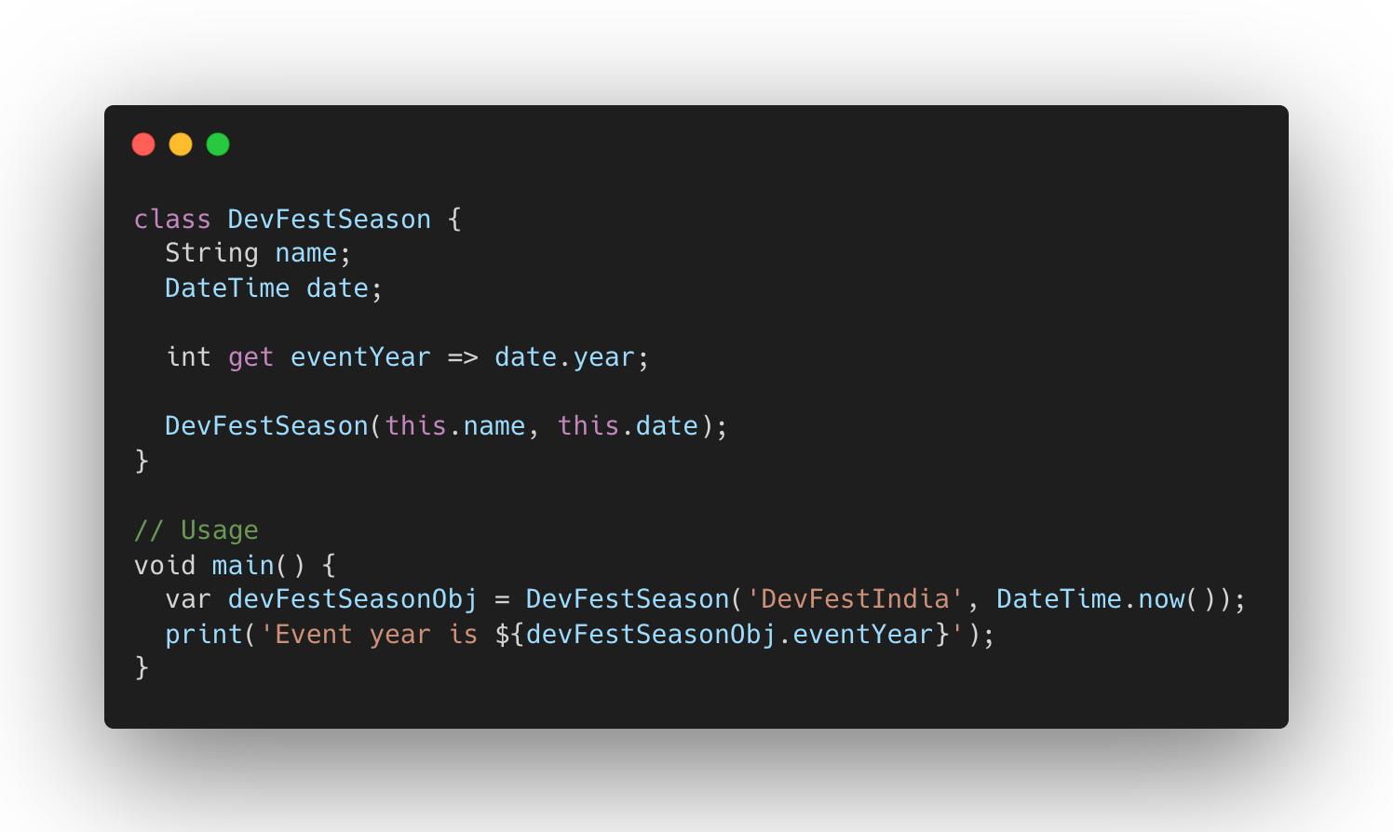
Classes

Slide 5
Basic of Dart
Class
Functions

Slide 6
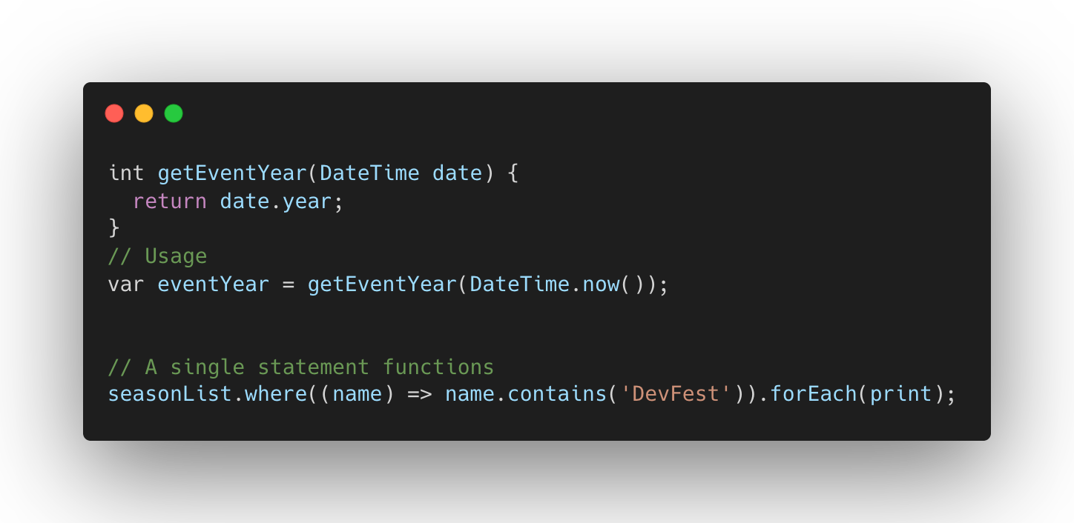
Functions

Slide 7
Basic of Dart
Class
Functions
Interfaces and abstract classes

Slide 8
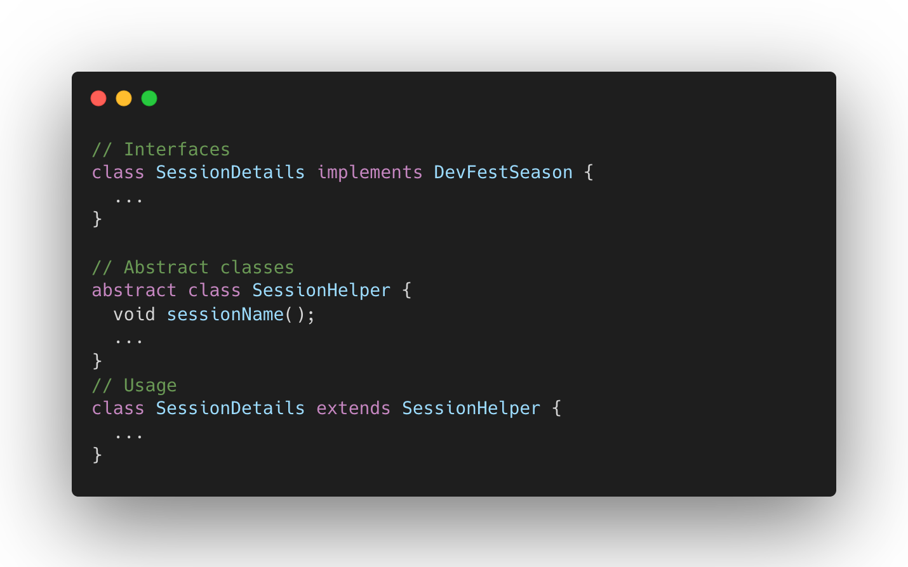
Interfaces and abstract classes

Slide 9
Basic of Dart
Class
Functions
Interfaces and abstract classes
Private

Slide 10
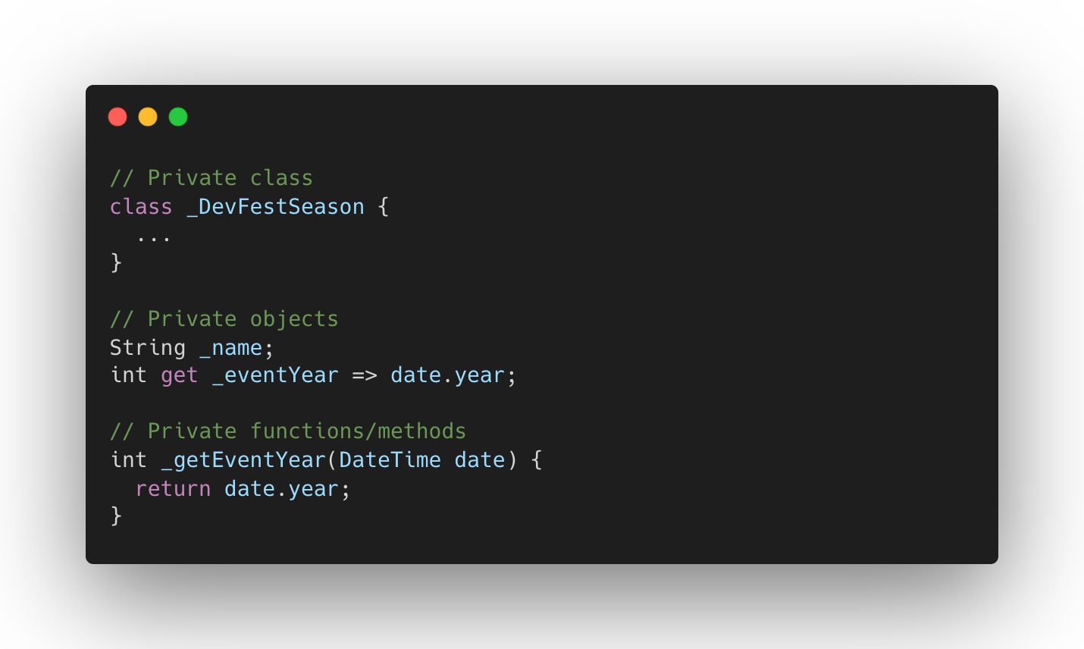
Private

Slide 11
Why Dart?

Slide 12
Why Dart?
A client-optimized language
A wide variety of compilation targets (Web, Mobile, and Desktop)
Forms the foundation of Flutter

Slide 13
The Language

Slide 14
Dart: The Language
Type Safe
Dynamic type
Offers sound null safety
A rich set of core libraries (collection, convert, math, io, async...)
- Take the Dart language tour to learn more

Slide 15

Optimized for UI

Slide 16
Optimized for UI
Async-await
Building user interfaces with such a cool features
Easy to learn with a familiar syntax

Slide 17

Productive development

Slide 18
Productive development
Hot reload
Rich static analysis
Debugging, logging, profiling support

Slide 19

Fast on all platforms

Slide 20
Fast on all platforms
AOT + JIT
Target the web with complete, mature, fast compilers for JavaScript
ARM32, ARM64, x86_64, JavaScript

Slide 21
Wow things of Dart

Slide 22
Wow things of Dart
Lambda functions

Slide 23
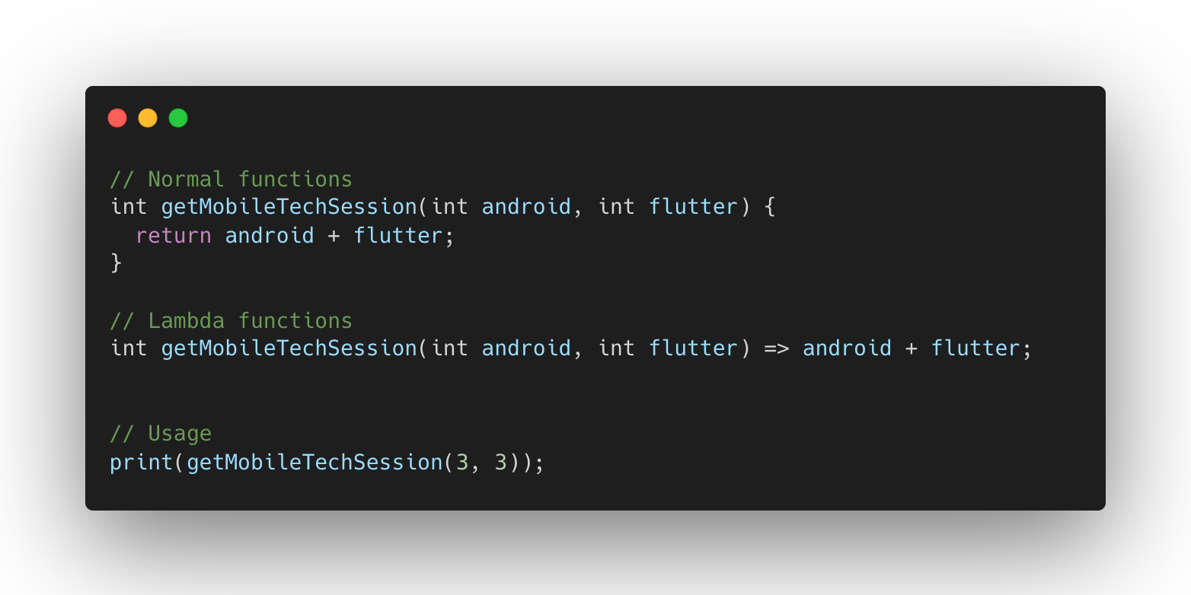
Lambda function

Slide 24
Wow things of Dart
Lambda functions
Higher Order functions

Slide 25
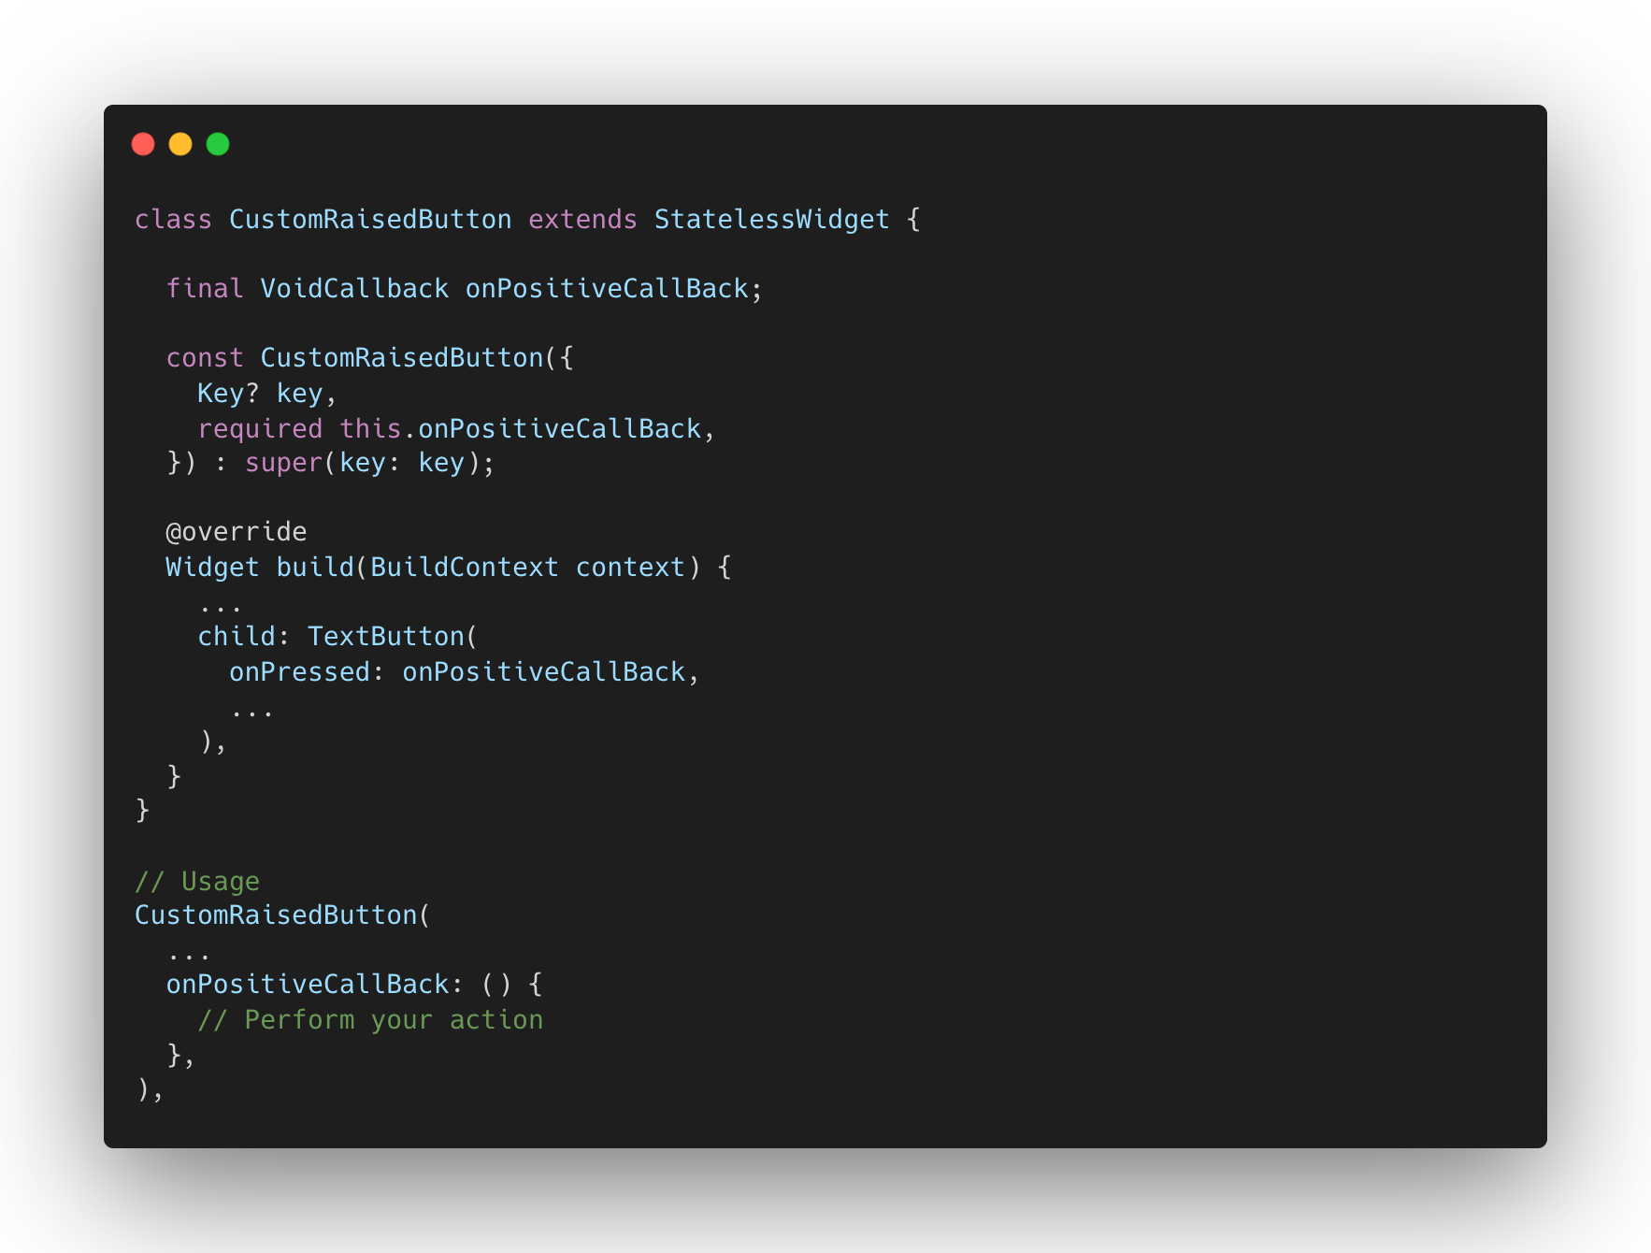
Higher Order Functions

Slide 26
Wow things of Dart
Lambda functions
Higher Order functions
Extension methods

Slide 27
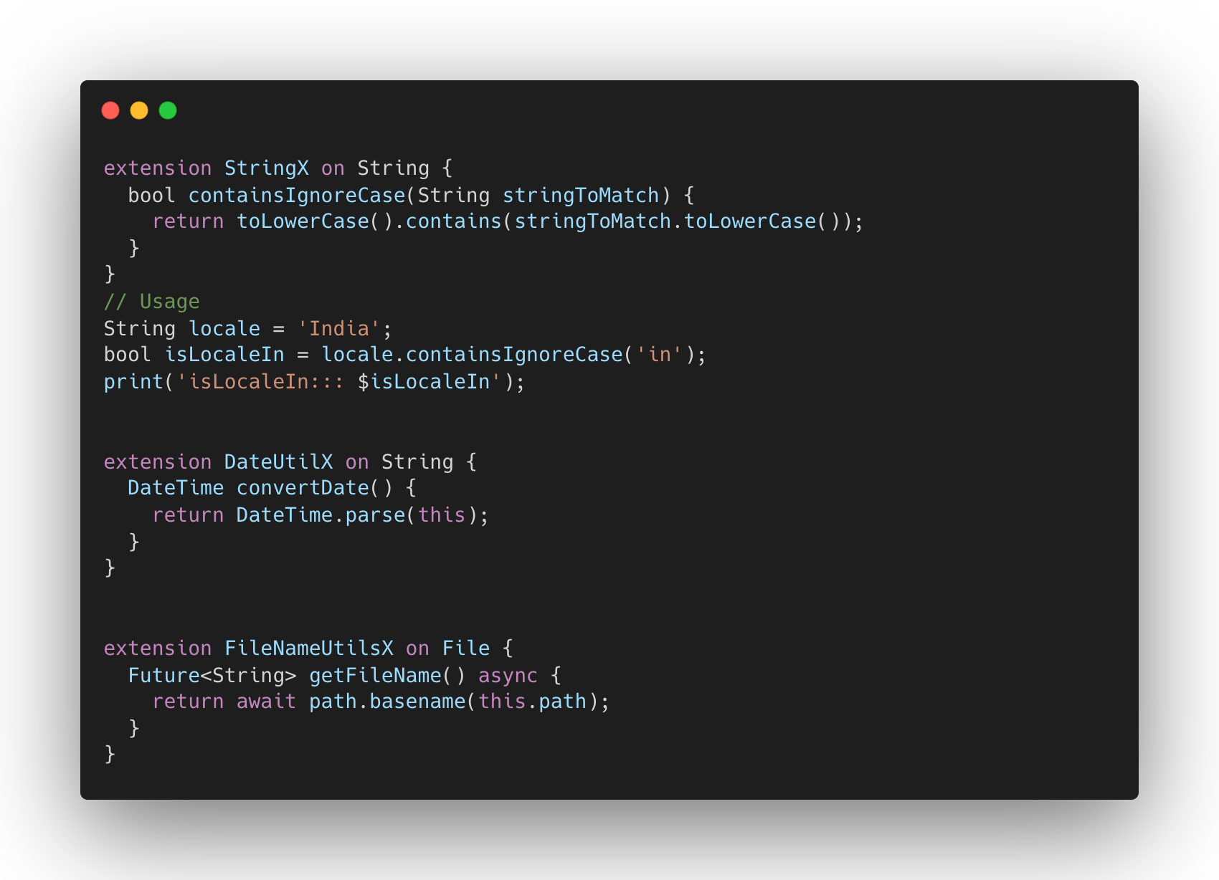
Extension methods

Slide 28
Wow things of Dart
Lambda functions
Higher Order functions
Extension methods
Null safety

Slide 29
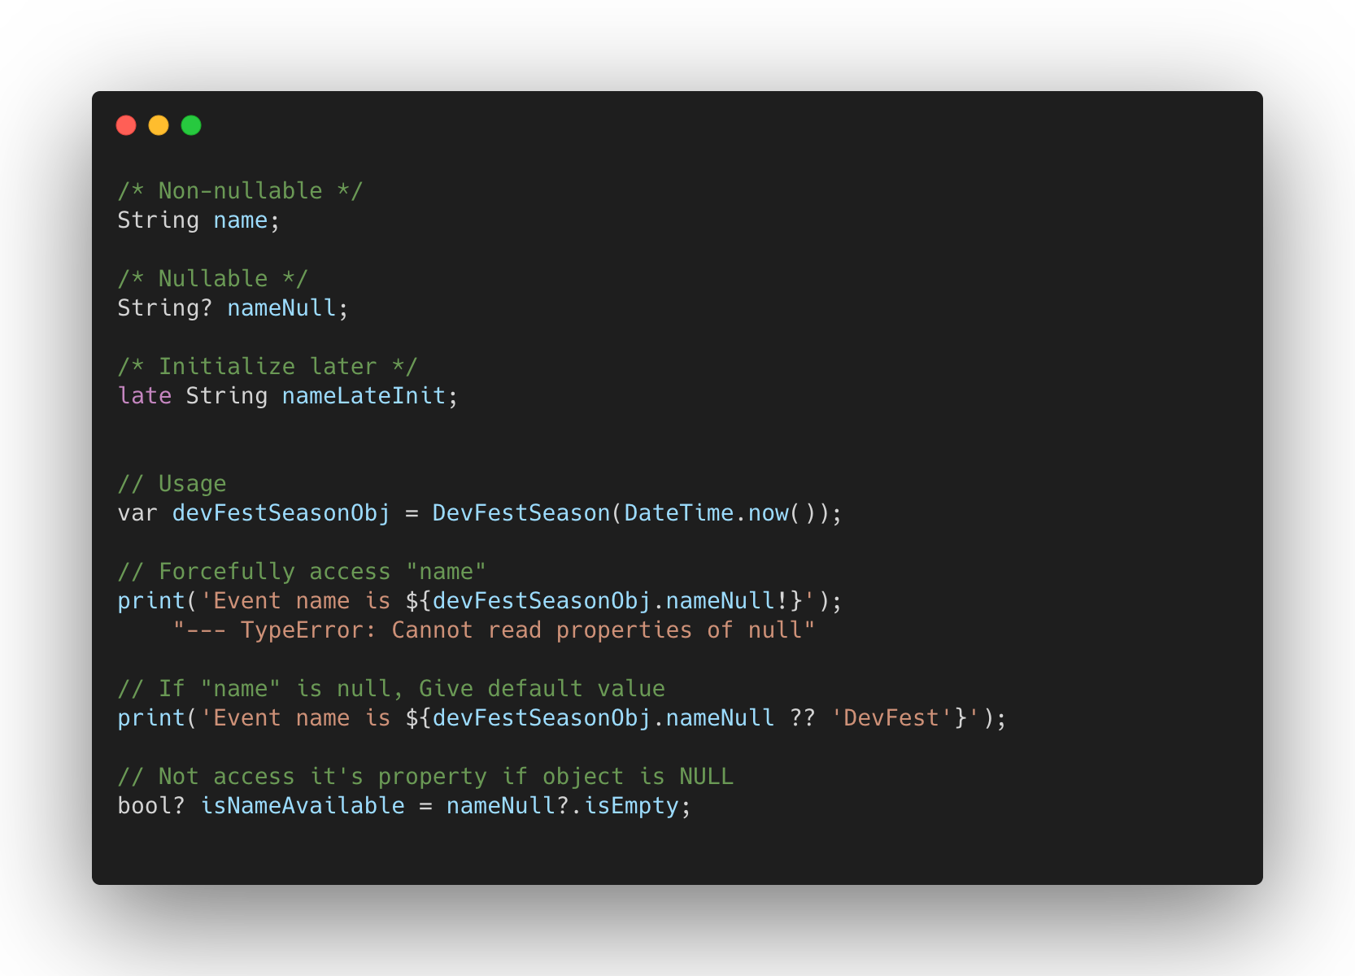
Null Safety

Slide 30

Useful links
Dart overview
Get the Dart SDK
Language tour
Language samples
Codelabs

Slide 31

Interview
Q&A

Slide 32
What is dart? What’s the benefits to use?

Slide 33
What are the Null-aware operators?

Slide 34
Difference between Final and Const?

Slide 35
Explain about Future, Async, Await?

Slide 36
What is the Dart DevTools?

Slide 37

@jaldeepasodariy

Slide 38
நன்றி!
ధన్యవాదాలు!
ধন্যবাদ!
Dank je!
Faleminderit!
നന്ദി!
توهان جي مهرباني!
धन्यवाद!
Ευχαριστώ!
ਤੁਹਾਡਾ ਧੰਨਵਾਦ!
谢谢！
ありがとうございました！
Thank you!
ขอขอบคุณ!
À ringrazià ti!
آپ کا شکریہ!
આભાર!
ကျေးဇူးတင်ပါတယ်!
Gràcies!
ಧನ್ಯವಾದ!
Jaldeep Asodariya
Sr. Mobile App Developer, GoHighLevel
@jaldeepasodariy
India

